Slide 1
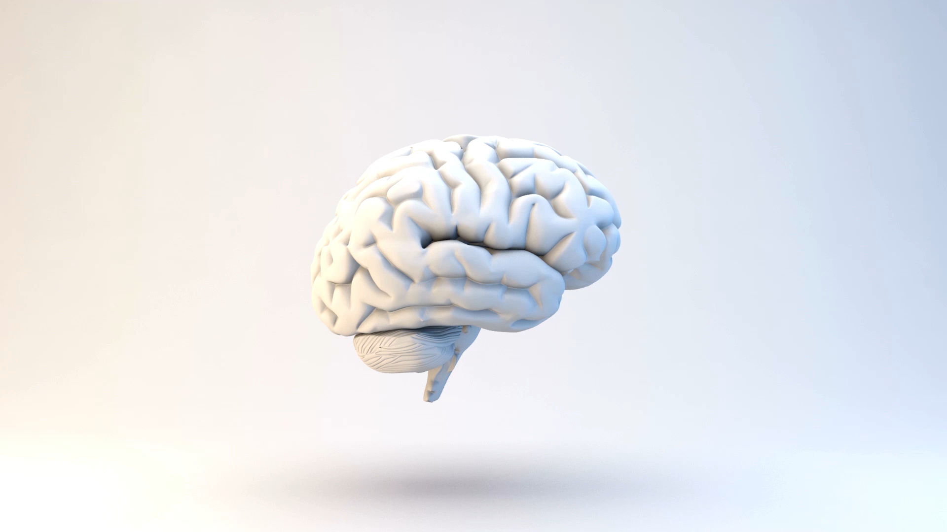

Research methods and techniques for Music PerceptioN and Cognition

Slide 2
How to “measure” (music) perception and cognition?
Surveys (not an experimental procedure)
Physiological measures
Behavioural measures
Electro-Encephalography (EEG):
Event-Related Potentials (ERP)
Magneto-Electro-Encephalography (MEG):
Positron Emission Tomography (PET)
Functional Magnetic Resonance Imaging (fMRI)

Slide 3
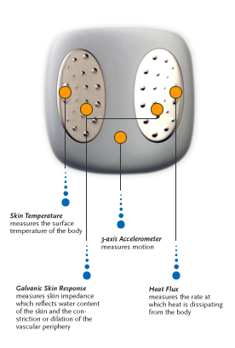
Physiological measures
Heart rate
Skin conductance
Blood pressure
Temperature
Muscle tension

Slide 4
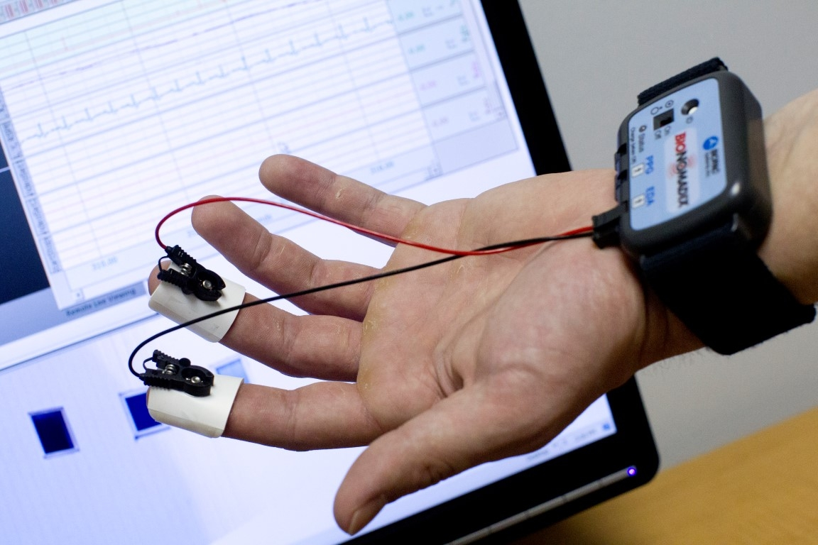
Physiological measures

Slide 5
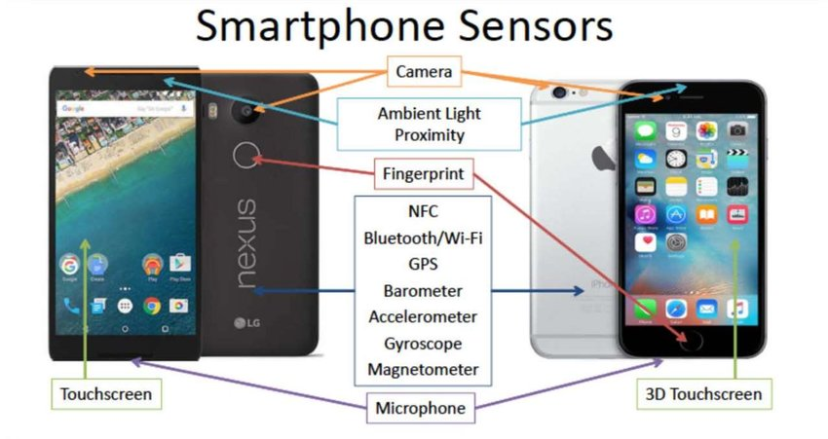
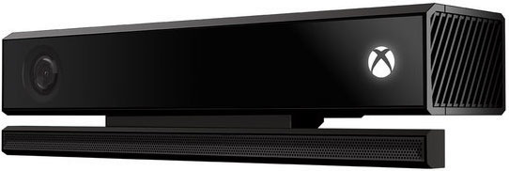
Behavioural measures
Errors solving a task
Reaction time
Relatedness, similarity (5 or 7 point Likert-type scale)
Choice (forced, not forced, 2, 3, 4 choices)
Eye-fixation
Motion Capture
Quantified Self

Slide 6
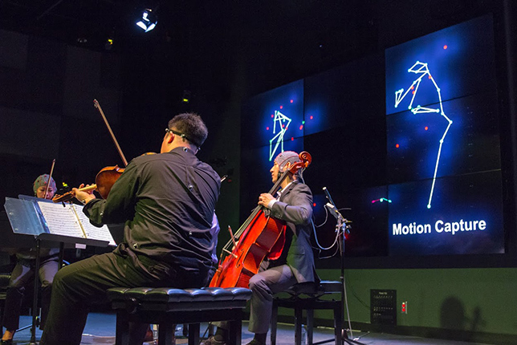
Behavioural measures

Slide 7
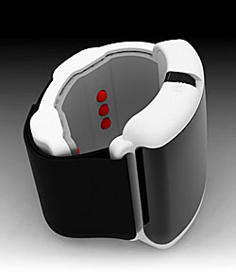
Behavioural measures

Slide 8
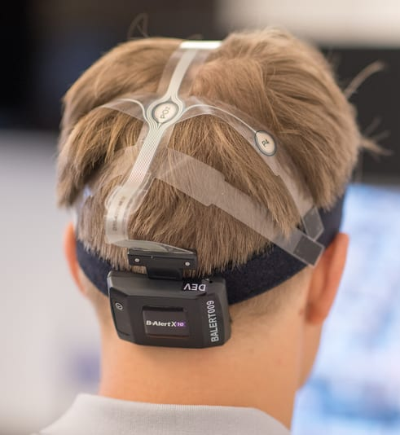
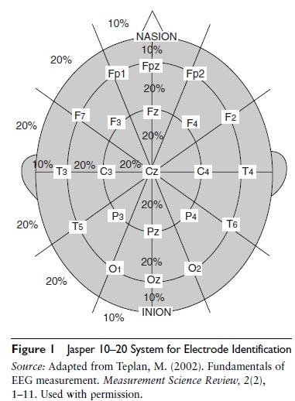
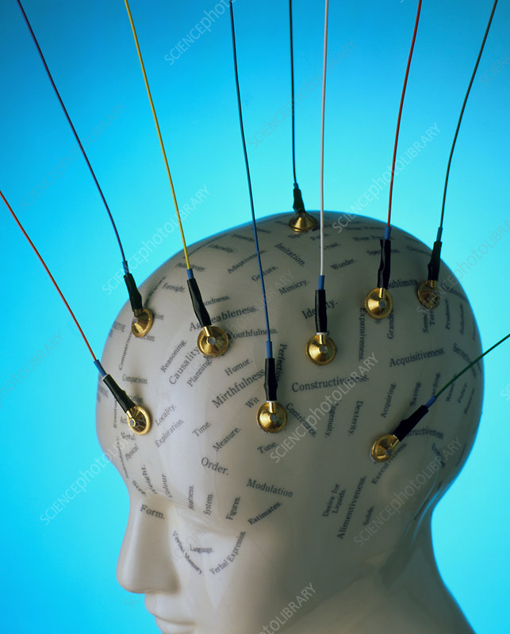
Electro-encephalography

Slide 9
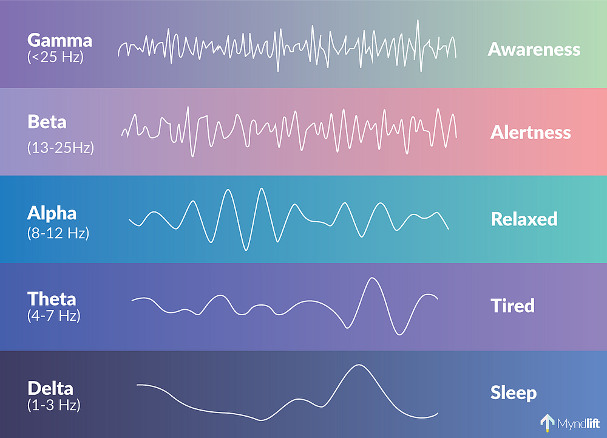
Electro-encephalography: spontaneous EEG

Slide 10
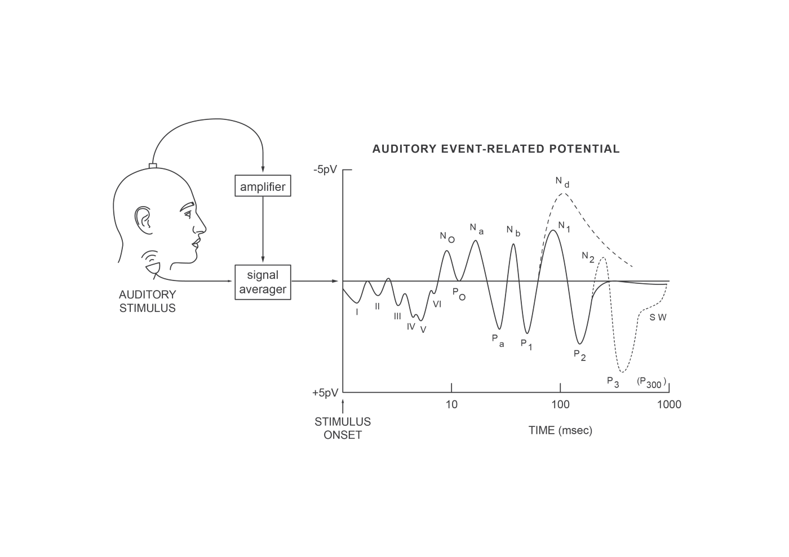
Electro-encephalography: Event-Related potentials (ERP)
When a sufficiently large number of neurons having a similar anatomical position and orientation are synchronously activated, their summed fields may be strong enough to be detectable as ERPs or ER Fields at the surface of the head.

Slide 11

Event-Related potentials (ERP)
ERP: neural signal that reflects coordinated activity of an ensemble of neurons, observed “after” certain events or stimuli have been processed
Good temporal resolution, poor spatial resolution
Pxxx: positive peaks, Nxxx: negative peaks
MMN: Mismatch negativity (80-200ms after the event.). It reflects the changes in the content of our auditory short-term memory (when something “new” is presented, a peak can be observed), even though we are not aware of that
N400 (200-500ms after the event): lack of semantic associations between terms or expressions
P600 (around 600ms): syntactic violations in language and in music

Slide 12
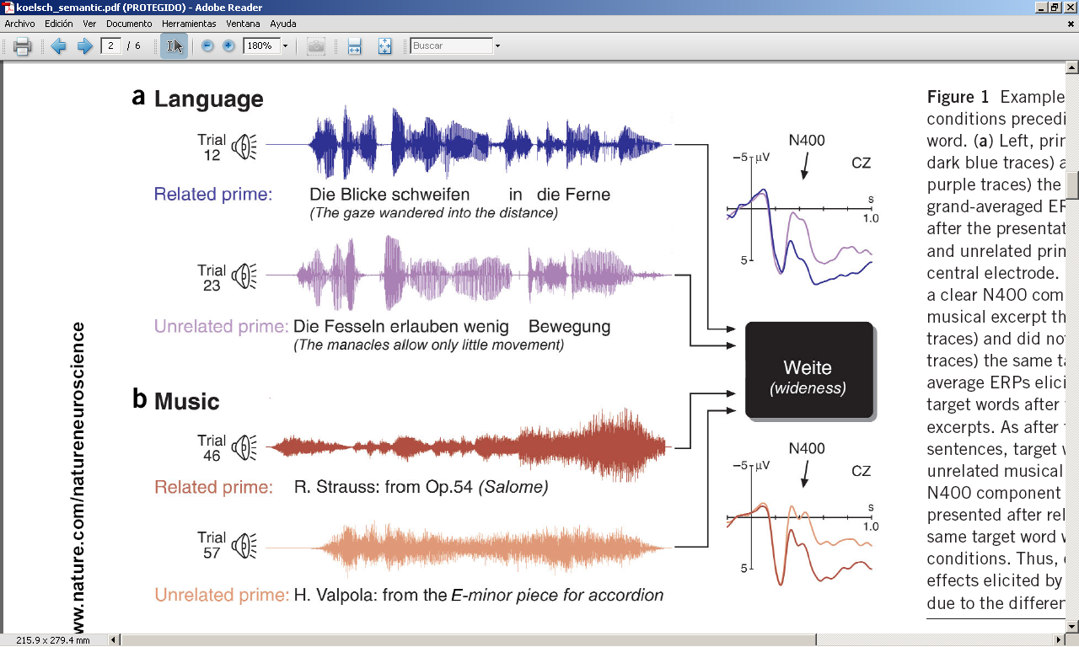
Event Related Potentials (ERP)
A semantic context is set either by speech (a) or by music (b)
Hearing unrelated words generate a negativity peak in centro-parietal electrodes around 400ms
The same N400 is observed when the context is set using music and the words have no semantic relationship with it
But when there is a semantic relationship between the prime and the word, the negativity is not observed
Koelsch et al. (2004). Music, language and meaning: brain signatures of semantic processing, Nature Neuroscience, 7(3).

Slide 13
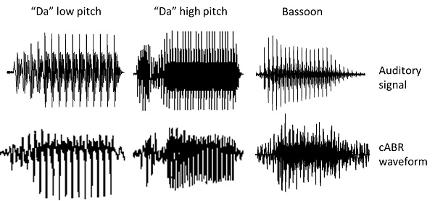
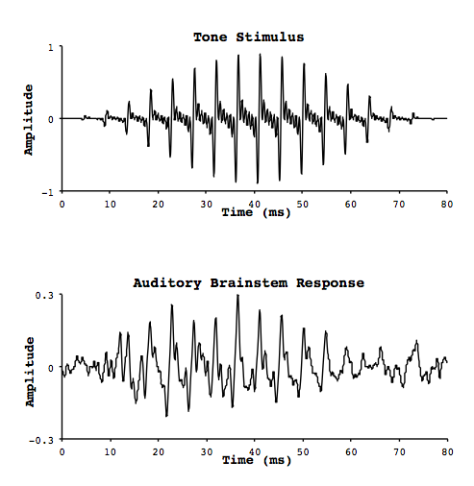
Frequency-following response (FFR, aka cABR)
cABR: auditory brainstem response to complex sounds
https://youtu.be/MWpW9UzM1h8?t=62

Slide 14
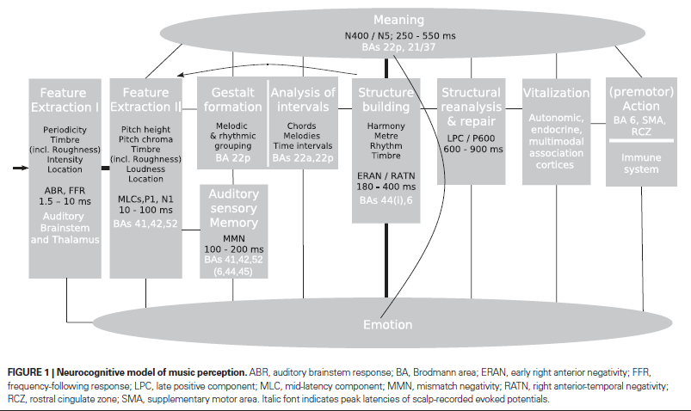
Timings in the musical brain (according to ERP studies)
Psychoacoustics
Music Cognition
Koelsch (2011). Toward a neural basis of music perception – a review and updated model
Trends in Cognitive Sciences

Slide 15
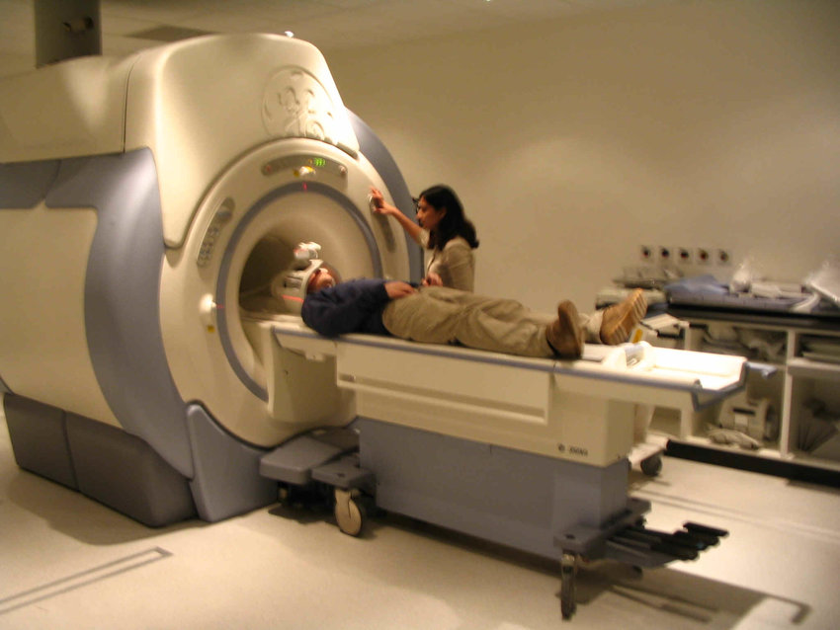
fMRI: functional magnetic resonance imaging

Slide 16
fMRI: Functional magnetic resonance imaging
Changes in oxygen consumption in particular areas of the brain, when performing a given task
Oxygen nuclei have nuclear magnetic resonance, i.e., their spins act as small magnetic fields and can be aligned according to a magnetic field
Depending on the metabolism (high vs low oxygenated blood), the spins misalign and then this process can be “plotted”
Excellent spatial resolution, bad temporal resolution
Non-invasive and innocuous
Mental paper cut & fold puzzles
Is there any brain listening to Beethoven? And to Mozart? And to Stockhausen?
Beethoven’s Fur Elise)
Mozart Sonata (K.448)

Slide 17
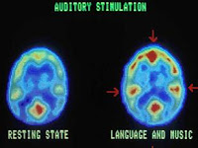
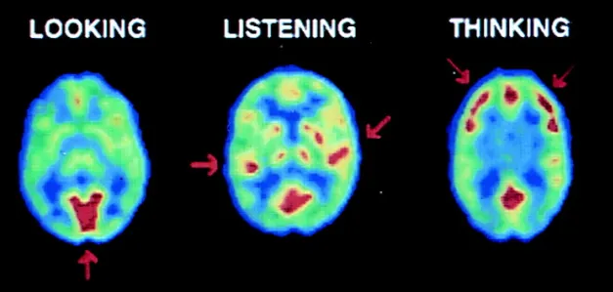
PET: Positron Emission Tomography
Radioactive contrast substance injected
Measurements of local blood flow, metabolism, neuro-receptor bindings...
Good spatial resolution, poor temporal resolution
Small health risk involved

Slide 18
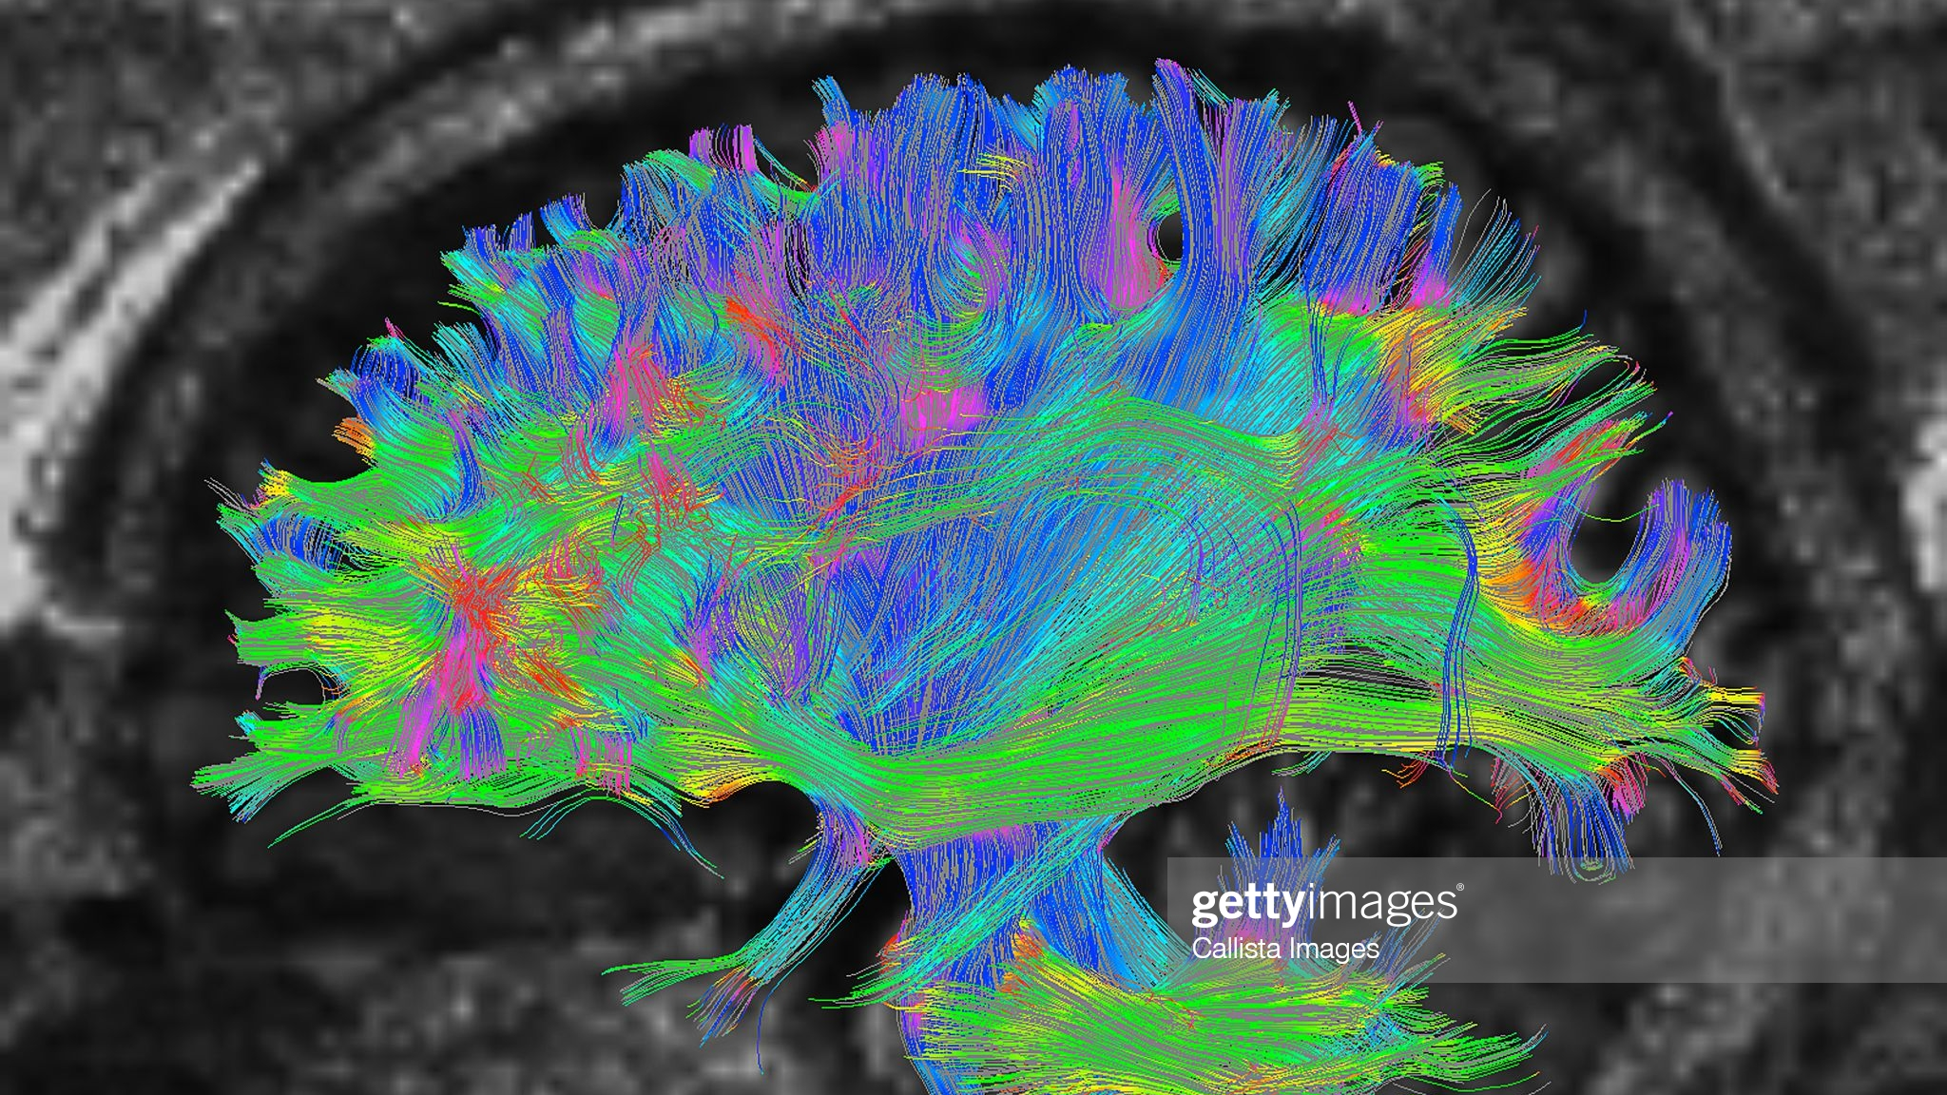
Difussion spectrum imagining

Slide 19
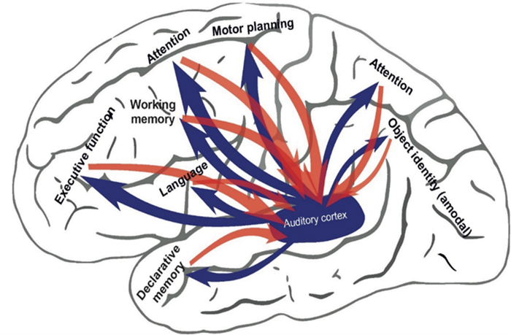
Difussion spectrum imagining
Mapping the gradient of wáter (instead of blood) molecule diffusion
Estimatation of the trajectories of neuron firing (instead of activity) in that área
Connectome revealed

Slide 20
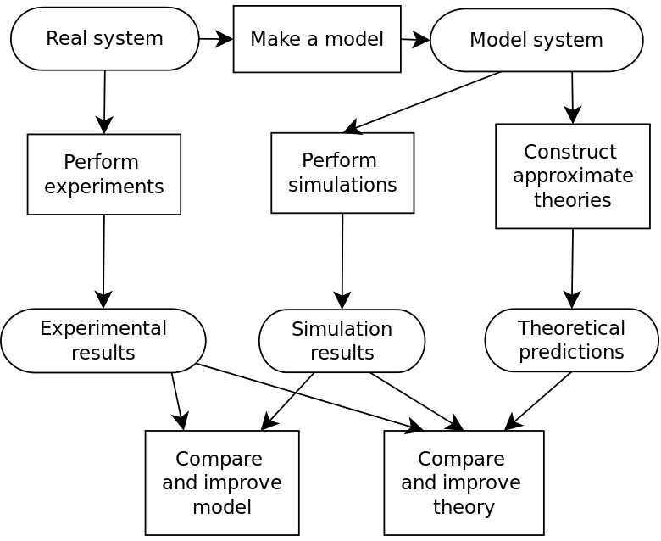
Computer simulation

Slide 21
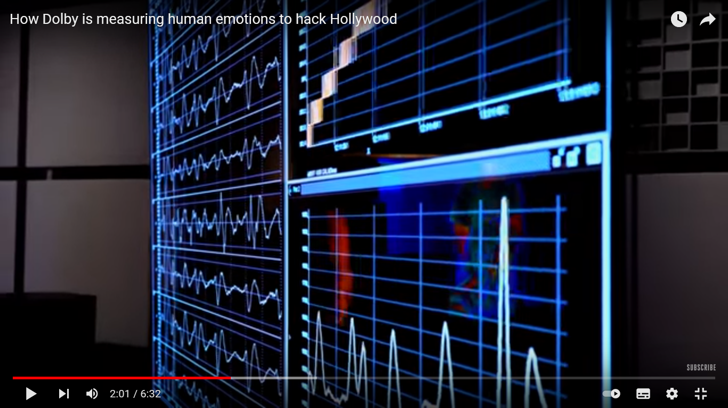
How dolby is measuring human emotions to hack Hollywood
https://www.youtube.com/watch?v=qYTT-0A8QIE&t=284s

